Slide 1


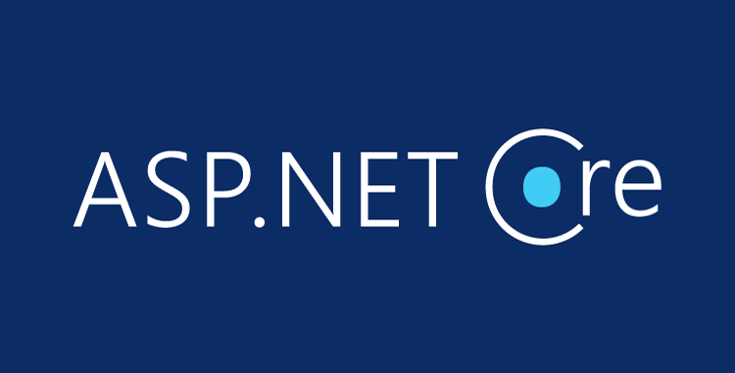

ASP.NET Core Introduction
Setup, Components Overview, Entity Framework
C# MVC Frameworks
SoftUni Team
Technical Trainers
Software University
http://softuni.bg

Slide 2
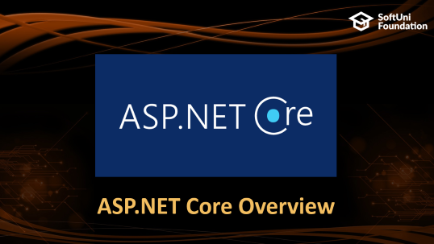

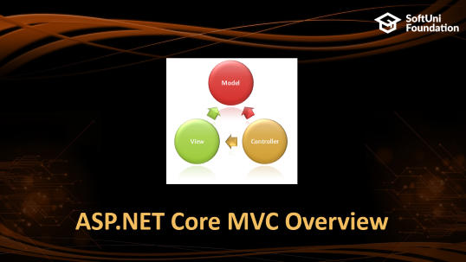
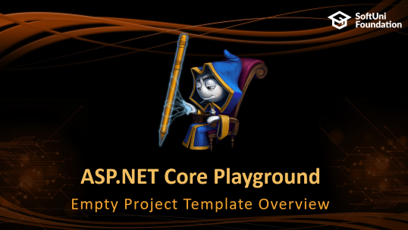
Table of Contents

Slide 3
Questions
sli.do #csharp-web

Slide 4
ASP.NET Core Overview

Slide 5
ASP.NET Core Overview
ASP.NET Core is a cross-platform, open-source framework
You can build web applications and services, IoT apps, and mobile backends with ASP.NET Core.
ASP.NET Core provides:
Integration of modern client-side frameworks and development workflows.
ASP.NET Core applications run both on .NET Core and .NET Framework.

Slide 6
ASP.NET vs ASP.NET Core
ASP.NET is a mature framework (v1.0 released January 2002)
Provides the services needed to build enterprise-class, server-based web applications on Windows.
ASP.NET Core is a relatively new open-source framework (v1.0 released June 2016)
Cross-platform framework
Suitable for building modern, cloud-based web applications on Windows, macOS, or Linux.

Slide 7
ASP.NET Overview
Sites
Services
Web Forms
Web Pages
MVC
Web API
SignalR
ASP.NET

Slide 8
ASP.NET Core Overview
Sites
Services
Web Pages
MVC
Web API
SignalR
ASP.NET Core

Slide 9
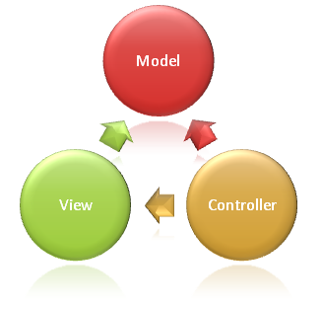
ASP.NET Core MVC Overview

Slide 10
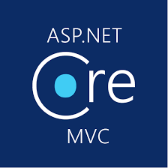
ASP.NET Core MVC
ASP.NET Core MVC is a rich framework for building web apps and APIs
Uses the Model-View-Controller design pattern
Lightweight, Open Source & Highly Testable
Optimized for use with ASP.NET Core
Provides patterns-based ways to build dynamic websites

Slide 11
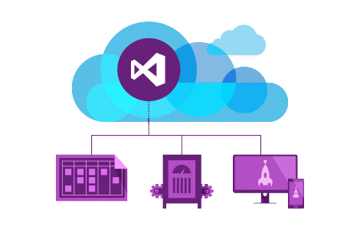
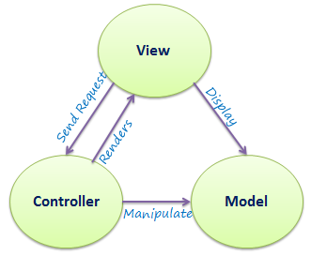
ASP.NET Core MVC
ASP.NET Core MVC makes it easy to:
Create SEO-friendly URLs
Create Single Page applications
Achieve Separation of Concerns
Adopt REST concepts
Implement Test Driven Development
Achieve high-quality architecture design, optimizing developer work (Convention over Configuration)

Slide 12
ASP.NET Core MVC
ASP.NET Core MVC provides cool features like:
Razor View Engine
One of the greatest view engines
With IntelliSense, integrated in Visual Studio
Support for building Web APIs
Building services that can reach a broad range of clients
Support for cross-origin resource sharing (CORS)

Slide 13

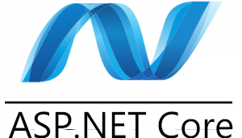
ASP.NET Core MVC
Along with those ASP.NET Core MVC provides features like:
Routing
Model binding & Model Validation
Dependency Injection
Filters & Areas
Strongly-Typed Views & View Components
Tag Helpers
And many more …

Slide 14

Setting up SDK
Setup SDK, Installation and Configuration

Slide 15
ASP.NET Core Playground
Empty Project Template Overview

Slide 16

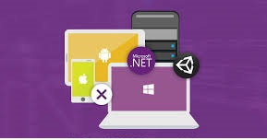
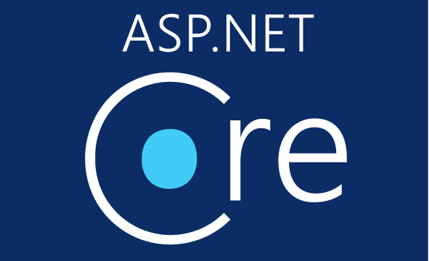
Summary
ASP.NET Core is a great platform for developing Internet applications
Easily Extensible
Highly Testable
Well Designed

Slide 17
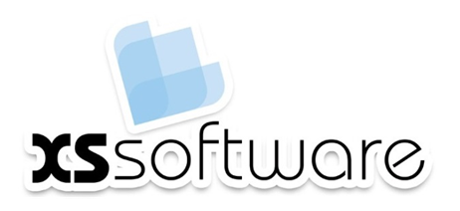






C# MVC Frameworks – Course Overview
https://softuni.bg/courses/asp-net-mvc

Slide 18
License
This course (slides, examples, demos, videos, homework, etc.) is licensed under the "Creative Commons Attribution-NonCommercial-ShareAlike 4.0 International" license

Slide 19





Trainings @ Software University (SoftUni)
Software University – High-Quality Education, Profession and Job for Software Developers
softuni.bg
Software University Foundation
http://softuni.foundation/
Software University @ Facebook
facebook.com/SoftwareUniversity
Software University Forums
forum.softuni.bg

